Slide 1
Recommenders for Social Places
Jia Tan A20433208
Jiajia Liu A20426786

Slide 2
Project Description
This project is designed for recommending social places for users, such as restaurant, coffee, shopping mall and club&bar.
User can search a place by categories, name of place and location.
When user create an account and edit user’s profile. The application will store this profiles as the user’s preference. For example, if the user is female, this application will more likely to recommend shopping malls for her.
The application also recommend some places through user’s searching history, for example, if an user search restaurant with street parking, this application will recommend restaurants with street parking for the user next time.
Users can write views for a place according to their experience.
Google Places API and Yelp API will be used in this application.

Slide 3
Requirements technologies
•Servlet
•Bootstrap
•CSS
•HTML/HTTP
•XML
•MongoDB
•MySQL
•JavaScript

Slide 4
API Technologies
•Yelp API
Use Yelp API to get some places in a location(Business search):
https://www.yelp.com/developers/documentation/v3/business_search
And get business details, such as photos, rating, price levels and hours of operation(Business Details):
https://www.yelp.com/developers/documentation/v3/business
•Google API
Use Google API to get current location(Places API for Web):
https://developers.google.com/places/web-service/intro
and display map in list page(Maps static API):
https://developers.google.com/maps/documentation/maps-static/intro

Slide 5
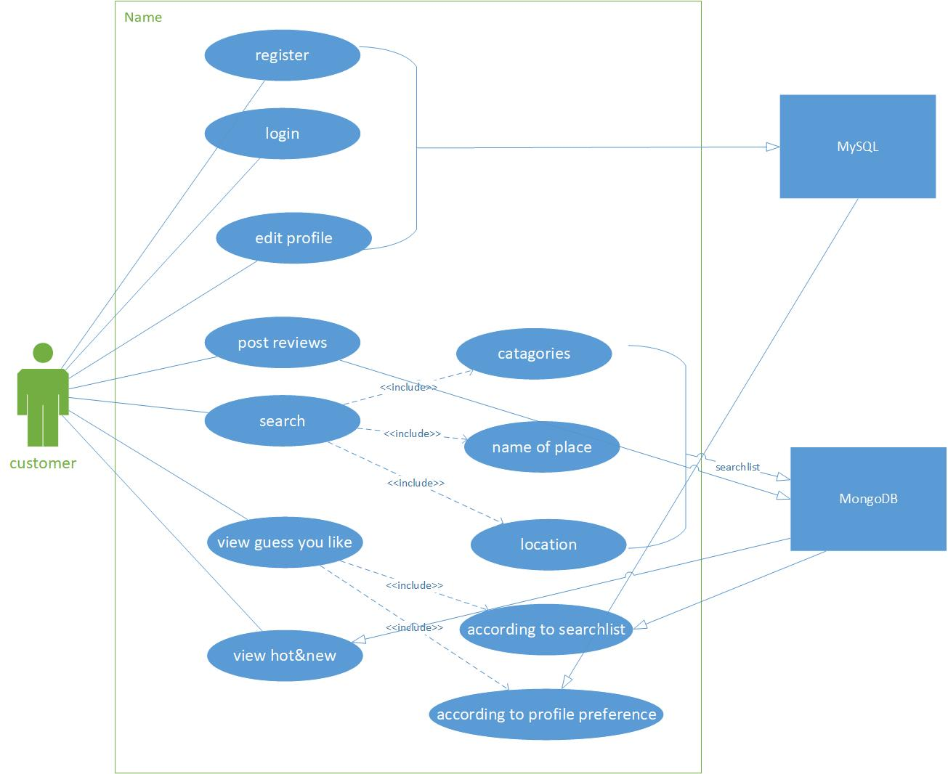
Use case diagram

Slide 6
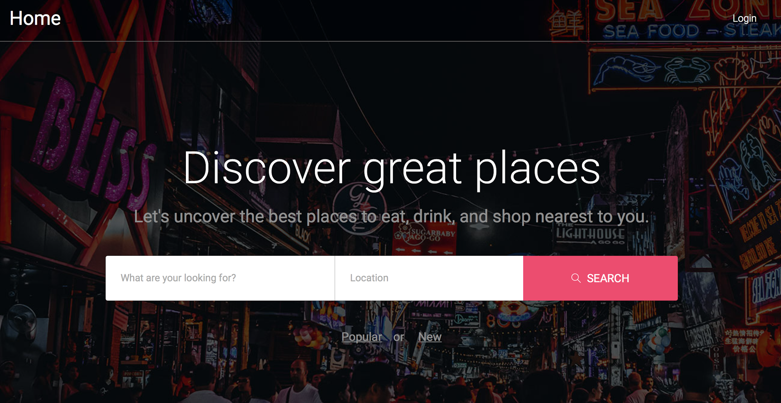
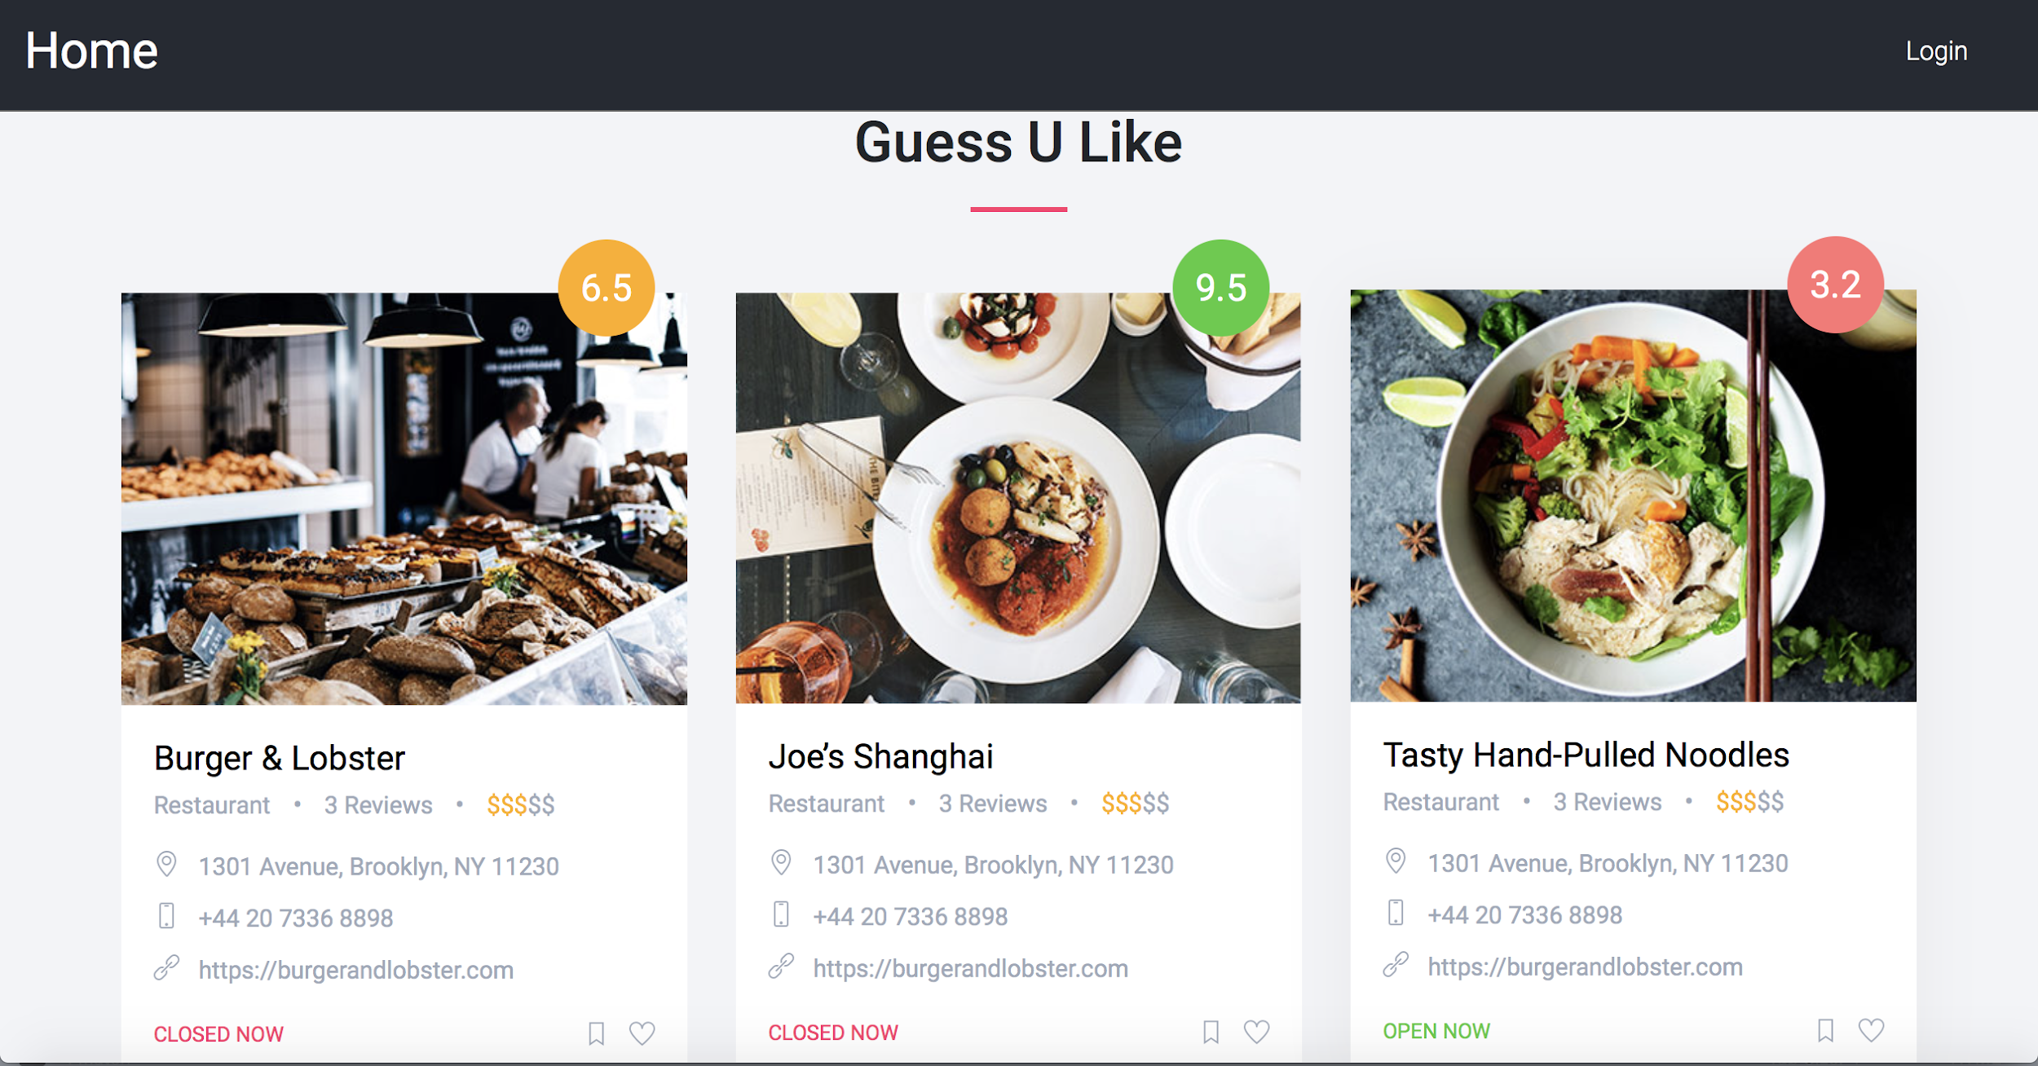
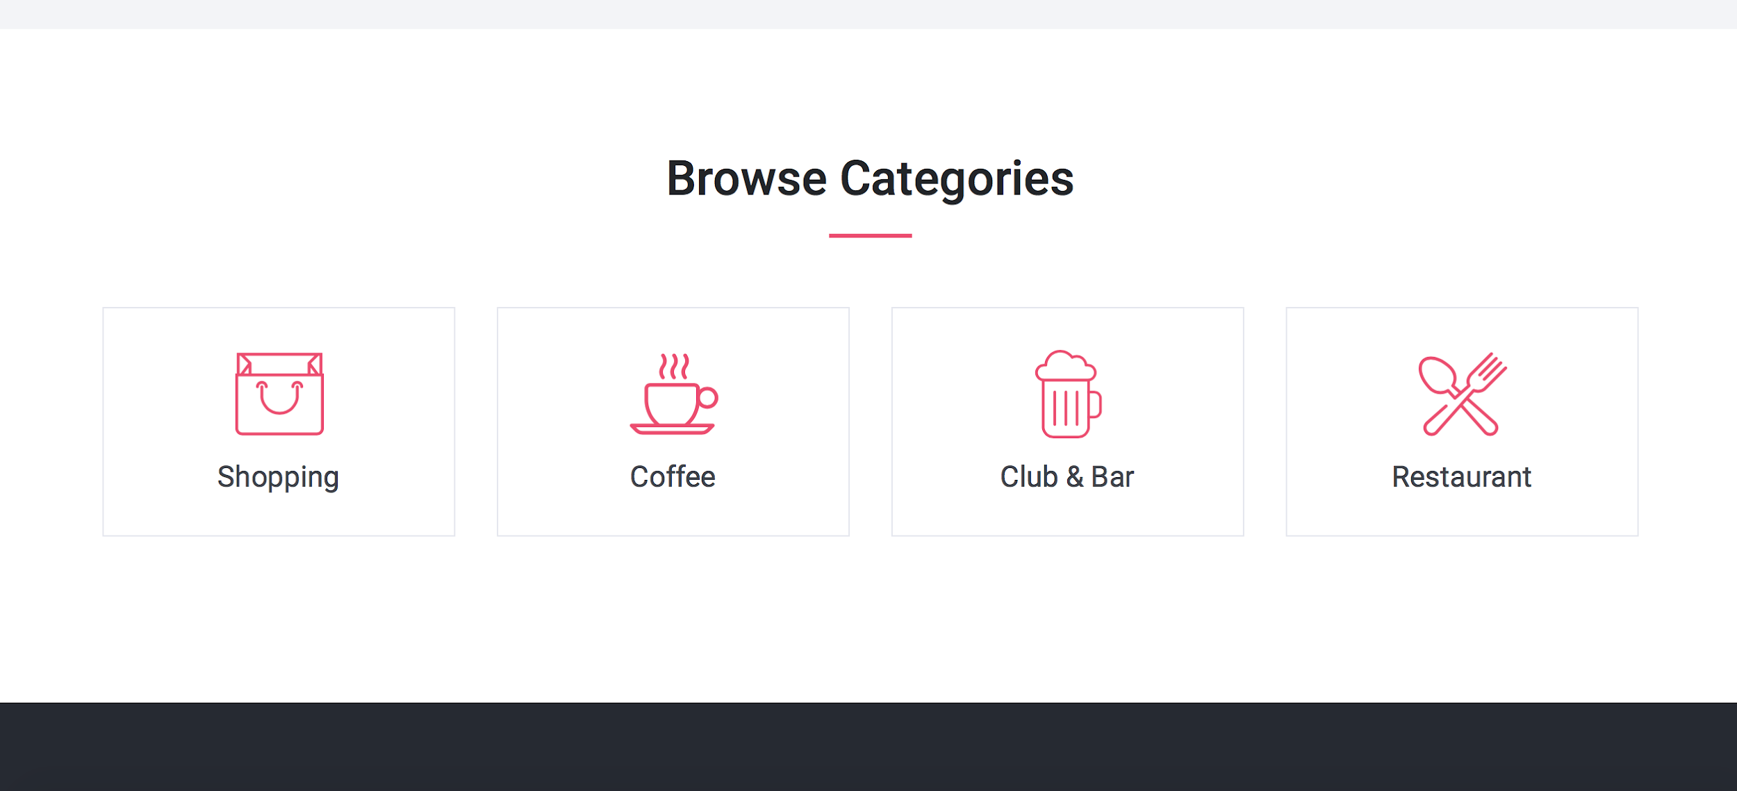
User Interface

